Slide 1

BRIGHT COFFEE
SHOP
SALES ANALYSIS &
STRATEGIC INSIGHTS
"Bringing Happiness in Every Cup"
Presented by : Zidella Morethe
Date: 30 June 2025

Slide 2
OBJECTIVE
The objective of this this presentation is to communicate the key findings from the sales analysis and provide strategic recomendations for decision making.

Slide 3
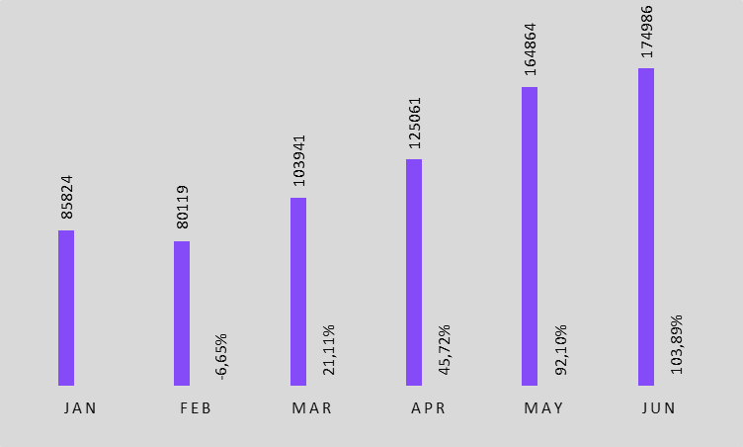

MONTHLY REVENUE WITH %CHANGE
Following a decline of 6,65% in February , Bright Coffee experienced a strong and accelerating growth .
Revenue doubled in just four months, signaling strong performance recovery and business momentum

Slide 4
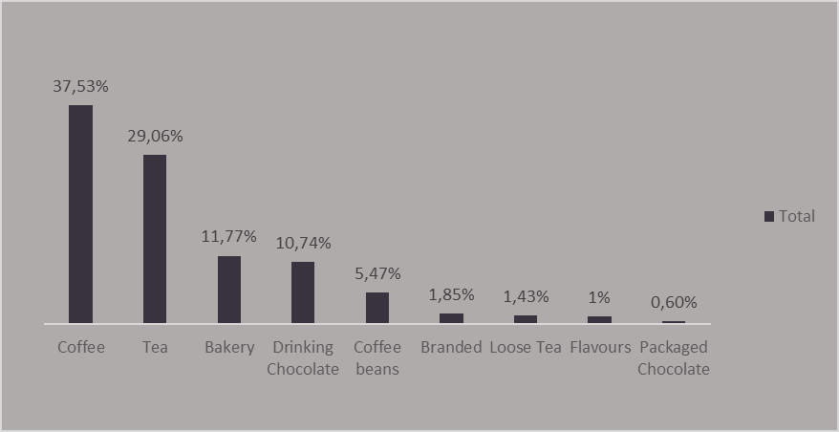

PRODUCTS REVENUE TRENDS
Coffee products account 37,53%
of the total revenue, significantly outperforming other categories. Tea contributes (29,06%),Bakery (11,77%),Drinking Chocolate(10,74%),Coffee beans(5,47%) and other products (4,88%)

Slide 5
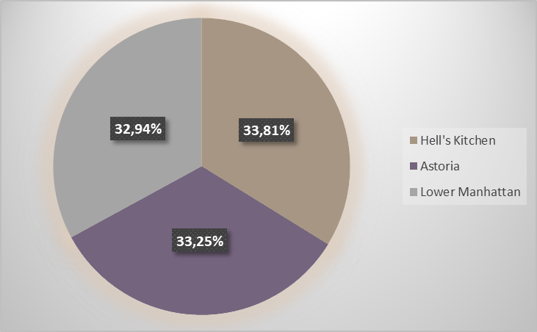

REVENUE CONTRIBUTION BY STORE LOCATION
All three locations contribute nearly equal to total revenue
Hell’s kitchen slightly leads with 33,81%,
followed by Astoria at 33,25%,
and Lower Manhattan at 32,94%.
Revenue is evenly distributed across all store locations , showing operational balance .

Slide 6
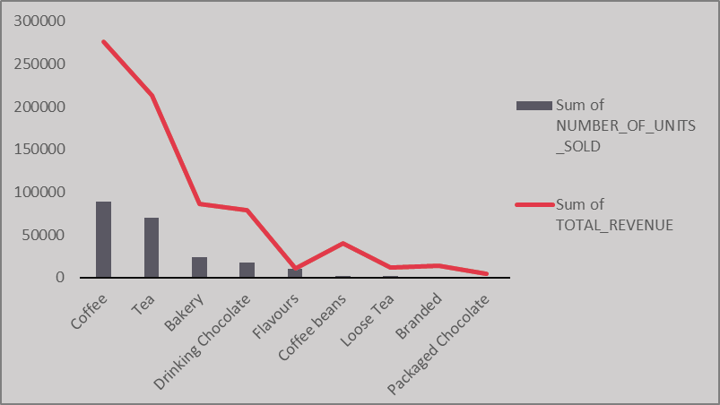

PRODUCT PERFORMANCE:VOLUME VS REVENUE IMPACT
Product performance reveals three product categories
Core drivers like Coffee, Tea, Bakery, Drinking Chocolate deliver both high volume and revenue.
Balanced performer such as Flavours shows a direct units-revenue correlation making them steady sellers.
Premium products such a Coffee beans, Loose Tea, Branded and Packaged chocolate generate high revenue, indicating strong margin potential .

Slide 7
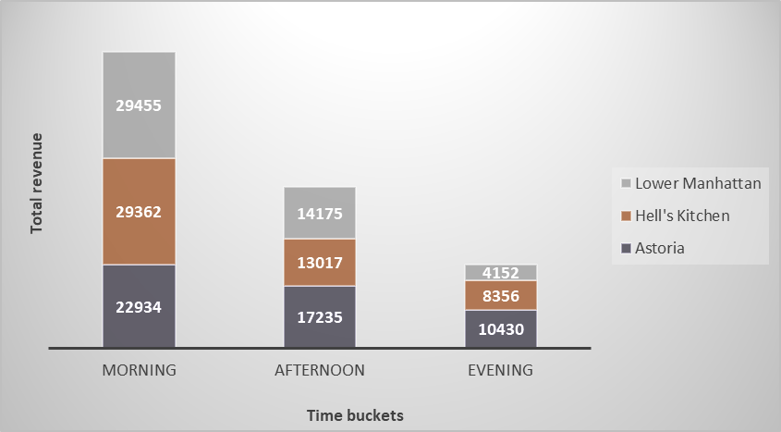
PEAK HOUR SALES PER STORE LOCATION
sales activity across the stores follows a clear pattern sales are highest in the morning ,drops slighthly in the afternoon and reaches a low point in the evening.
Lower Manhattan dominates the mornings , indicating strong customer engagement.
Astoria take the lead in both the afternoon and the evenings.
Hell’s Kitchen mainly ranks in the middle across all time slots .

Slide 8
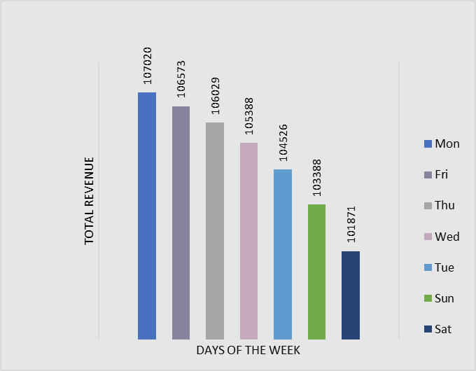

PEAK SALES DAYS
Monday generates the highest total revenue of the week, followed by Friday, Thursday ,Wednesday and Tuesday. Sunday and Saturday show the lowest sales activity, suggesting that weekends are the weakest revenue periods for the store.

Slide 9


key findings
recommendations
Most of the sales occurs during morning across all the stores.
Prioritise staffing, stock and promotions during morning hours . Launch ‘Early Bird’ combos and loyalty perks.
Weekdays generates higher revenue compared to weekends, with Monday outperforming other days.
Maximise operations and marketing on weekdays especially Monday.
Use weekends to clear slow-moving stock with discount promotions.
Products categories such as coffee, tea and bakery drive most of our revenue.
Ensure consistent availability and visibility of these top selling products.
Bundle them with other products to drive upsells.
Feature them in promotions and loyalty programs to increase repeat purchases.

